Slide 1

STELLA OBASANJO HOSPITAL Edo state ministry of Health
CIVIL WORKS IN 0PD BLOCK
CIVIL WORKS IN IPD BLOCK
PROJECT WEEKLY ACTIVITIES
FINANCIAL DETAILS
PICTURE EXCERPTS
PROGRESS REPORT: WEEK 7
(13th – 18th February 2023)
TANIT MEDICAL ENGINEERING
TANIT MEDICAL ENGINEERING February 2023

Slide 2
Civil works in OPD block
% PERCENTAGE COMPLETION
14, February 2023
45.8%
Phase
ONGOING WEEK 7 ACTIVITIES
TANIT MEDICAL ENGINEERING
TANIT MEDICAL ENGINEERING February 2023

Slide 3
Civil works in IPD block
% PERCENTAGE COMPLETION
09, February 2023
0.75%
ONGOING ACTIVITIES
NIL
PREVIOUS ACTIVITIES IN IPD
Removal of suspended ceiling
Removal of sanitary wares
Removal Air-conditioners
All item carefully accounted for and stored in container on site
TANIT MEDICAL ENGINEERING
TANIT MEDICAL ENGINEERING February 2023

Slide 4
Project weekly activities
WEEK 7: 13th – 18th February, 2023
TASK/ACTIVITY |  |  |  | % EXPECTED CUMULATIVE TARGET (OPD & IPD)
OPD |  | IPD
Activity | % Expected Cumulative weekly target | Activity | % Expected Cumulative weekly target
Internal & External plastering works | 46.75 | Financial options payment and cash flow plan being processed | 0.75 | 24.25
General MEPF first fix
Block work in hydrotherapy pool pump house
Primer painting
In view : WEEK 8
TASK/ACTIVITY |  |  |  | % EXPECTED CUMULATIVE TARGET (OPD & IPD)
OPD |  | IPD
Activity | % Expected Cumulative weekly target | Activity | % Expected Cumulative weekly target
Internal & External plastering works | 48 | Financial options payment and cash flow plan being processed | 1
General MEPF first fix
Block work in hydrotherapy pool pump house
Primer painting
TANIT MEDICAL ENGINEERING
TANIT MEDICAL ENGINEERING February 2023

Slide 5
Financial Details
ACTIVITY | STATUS
OPD CIVIL WORKS | Interim valuation certificate for OPD Civil works currently been processed by MOH
IPD CIVIL WORKS | Contractor awaiting mobilization
MEDICAL & NON-MEDICAL EQUIPMENTS | Invoices received from vendors. Financial options payment and cash flow plan being processed Vendors awaiting mobilization
TANIT MEDICAL ENGINEERING
TANIT MEDICAL ENGINEERING February 2023

Slide 6
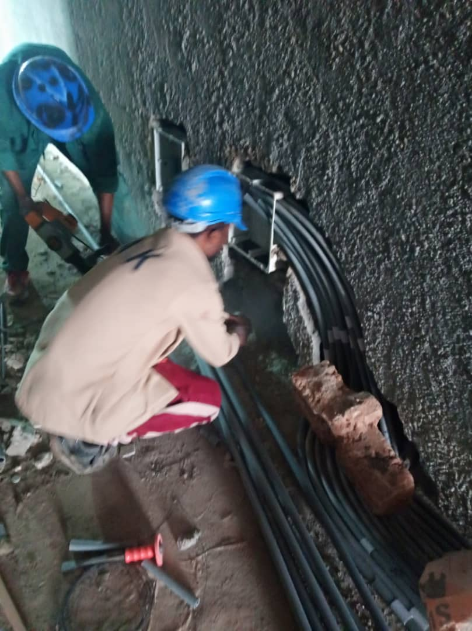
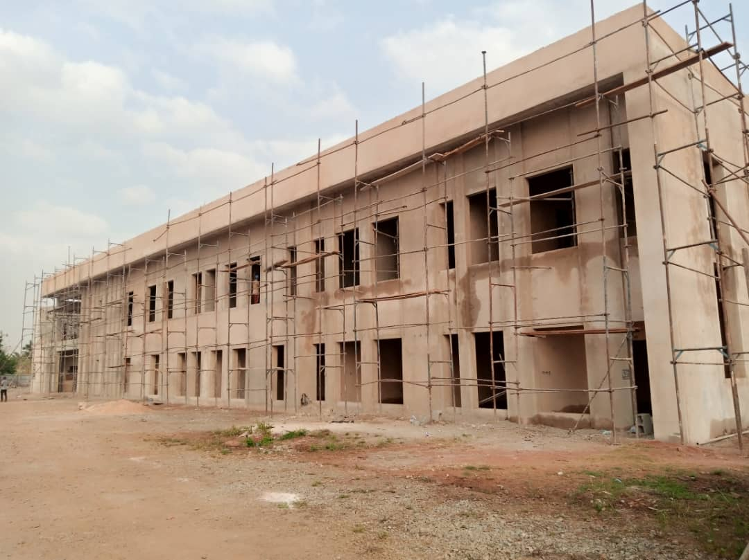
Picture excerpts
Electrical piping works in OPD
Perspective view of external plaster works in OPD
TANIT MEDICAL ENGINEERING
TANIT MEDICAL ENGINEERING February 2023

Slide 7
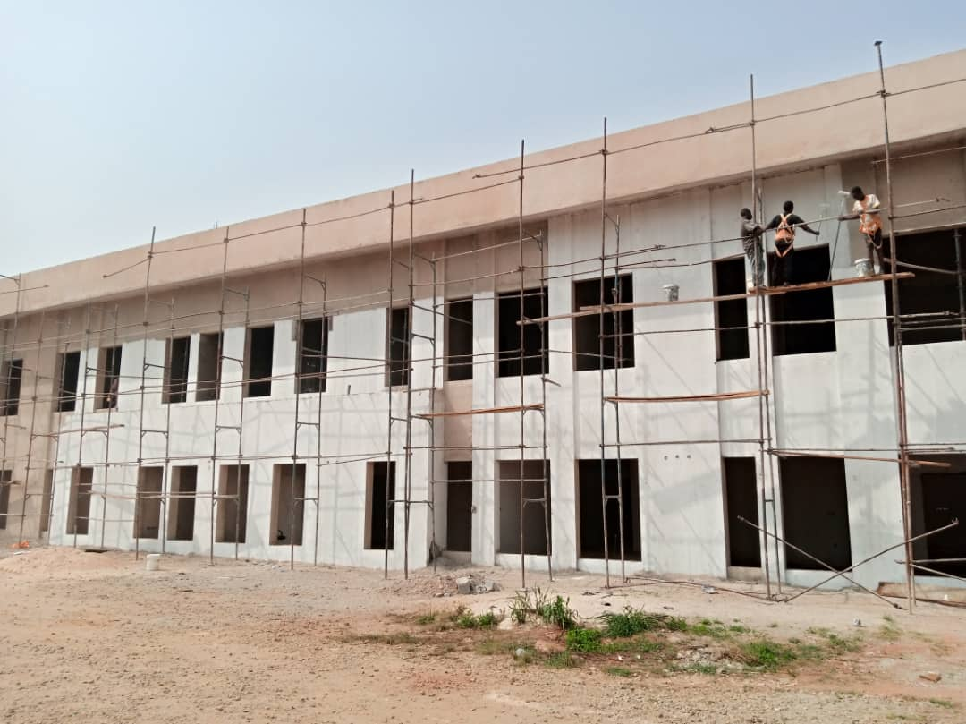
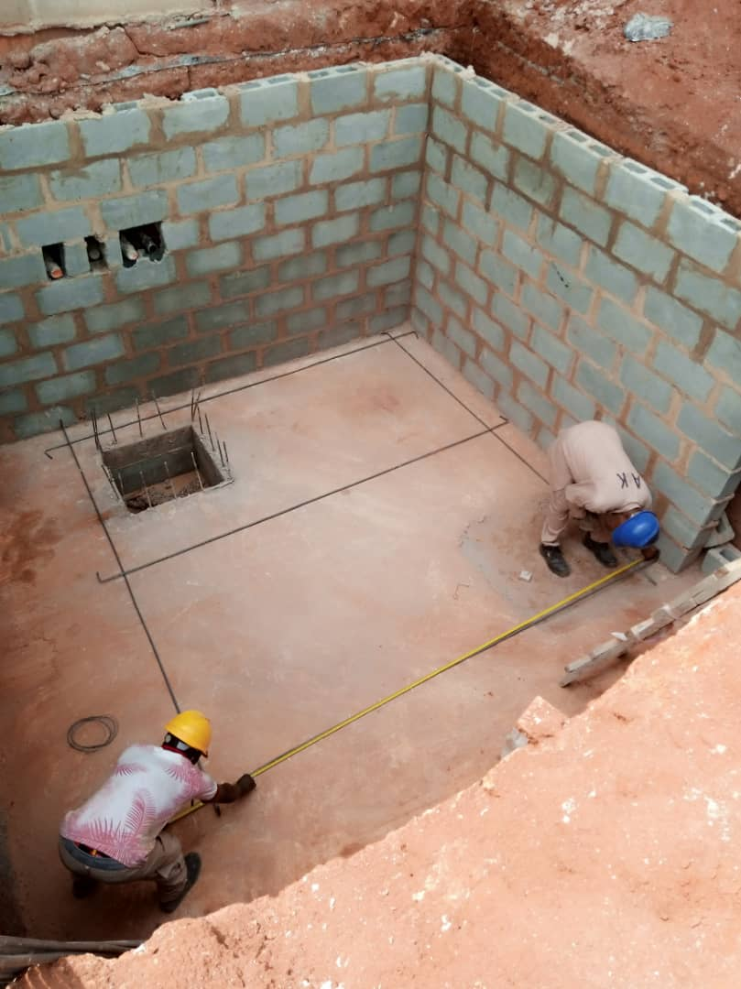
Picture excerpts
Primer painting works in OPD
Hydrotherapy pull pump house
TANIT MEDICAL ENGINEERING
TANIT MEDICAL ENGINEERING February 2023

Slide 8
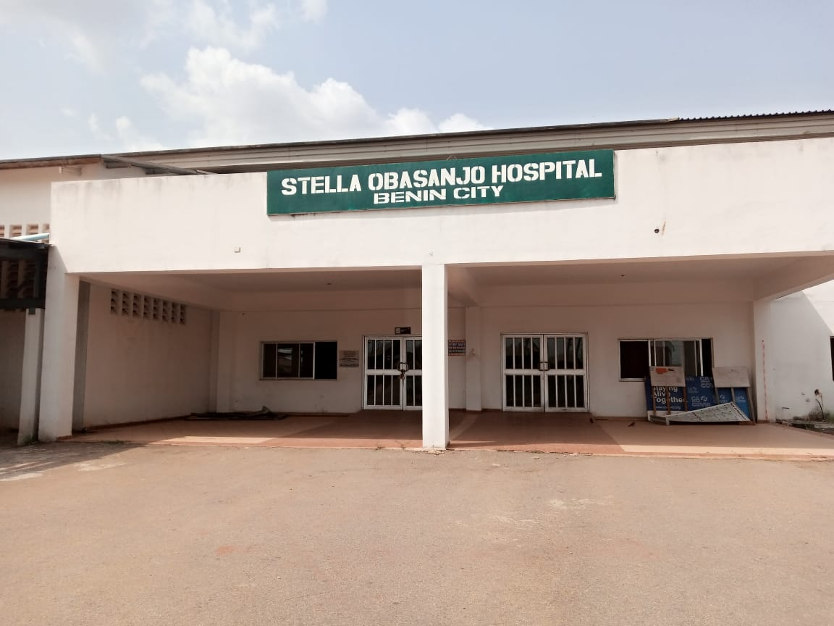
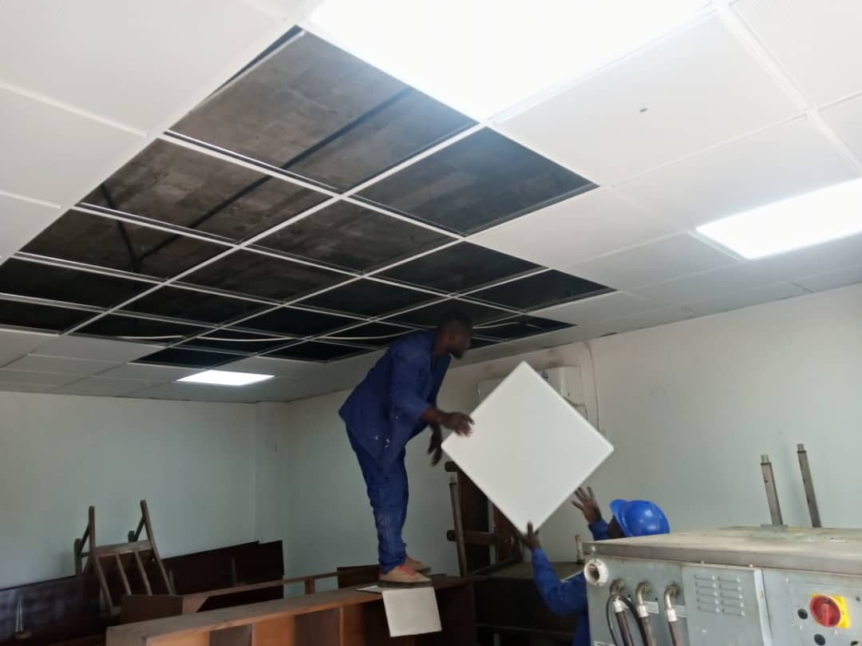
Picture excerpts
Front view perspective of IPD
Careful removal of suspended ceiling in IPD
TANIT MEDICAL ENGINEERING
TANIT MEDICAL ENGINEERING February 2023

Slide 9


End of presentation
Thank you for your time.
From all of us at
TANIT MEDICAL ENGINEERING
Let love lead
TANIT MEDICAL ENGINEERING
TANIT MEDICAL ENGINEERING February 2023

